Slide 1
The 10 Foundational Principles for a Healthy Mind
Michael B. Mantz, MD,MH
BOARD-CERTIFIED Psychiatrist
www.SBIntegrativePsychiatry.com

Slide 2
All material provided in this lecture is provided for informational or educational purposes only. Consult a physician regarding the applicability of any opinions or recommendations with respect to your symptoms or medical condition.

Slide 3
Principle #1: Nourish positive brain growth and destroy unhealthy brain structures

Slide 4
Neuroplasticity / BDNF – Create a Highly Adaptable Brain
100,000,000,000 interconnected neurons
Avg. Neuron = 10,000 connections – synapses
Number of firing patterns – # of possible mental experiences >
# of atoms in the known universe.
Virtually infinite # of states and choices –> being stuck -> just a thought
Two way street: brain firing patterns <-> your mental experiences
Reinforcing mind patterns => more powerful and faster connections 100x faster
Notes:
Page 38 mindsight, dial-up to cable

Slide 5
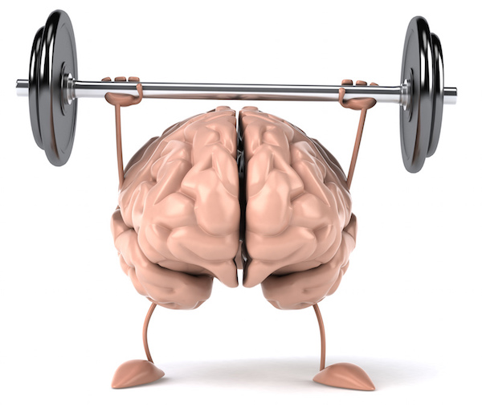
Neuroplasticity / BDNF – Create a Highly Adaptable Brain
-Sleep
-Exercise – turn up the intensity
-Omega 3 Fatty Acids (90-95% US Deficient)
-Blueberries (anthocyanin), Red Grapes (resveratrol), Curcumin
-Cocoa Flavonoids
-Resistant Starches – Butyrate
-Melatonin
-Digestive Rest (12hrs+)
-Close nurturing relationships
-Maintaining a healthy weight
-N.E.A.R.

Slide 6
Principle # 2: Give your brain the right raw materials to rebuild itself with and avoid unhealthy materials (sugar – oxidized fats)

Slide 7
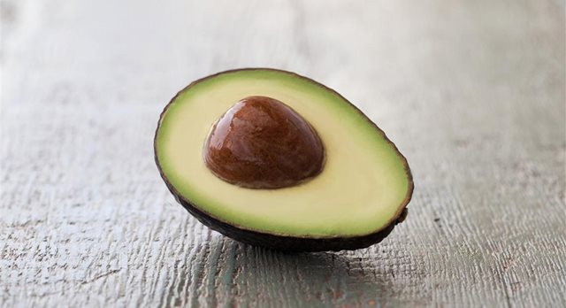
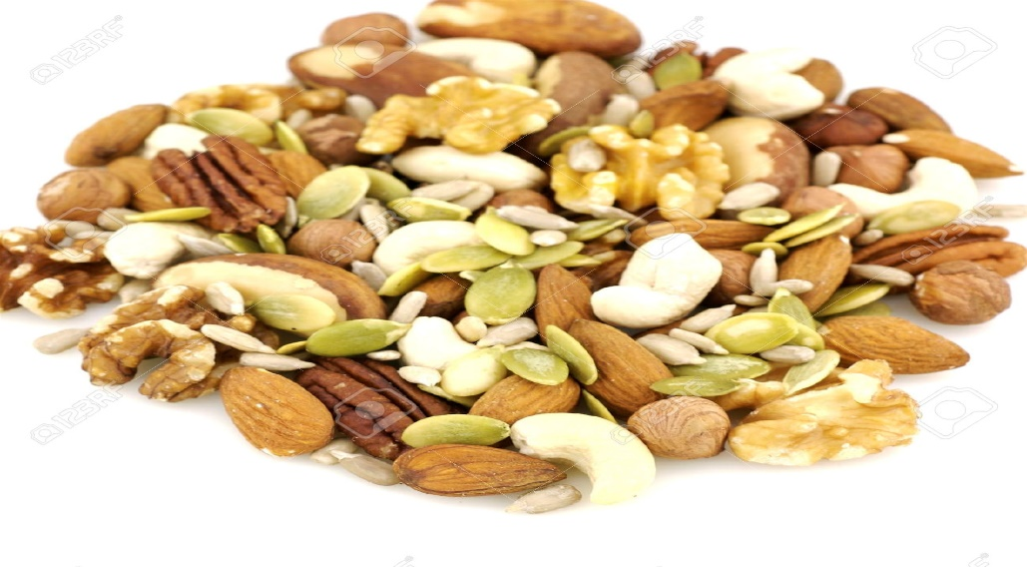
Your BRAIN Loves Healthy fats & fat nutrients: DEAK
Your brain loves healthy fats: 60% of fat makes up its structure.
Healthy Fats: Raw Nuts - Seeds – Avocadoes - Whole coconut
Omega 3 Fatty Acids: Flax, Chia, Walnuts, Hemp
Vitamin E: Almonds, Avocadoes, Sunflower Seeds

Slide 8
Superfruits – Memory Language Oxidation Inflammation
Pomegranates - Memory Performance & Retention (Brookheimer et. AL 2013) (Ropacki, et AL 2013)
Cherries - Verbal Fluency Short term/Long term memory (Cadwell et AL 2014)
Berries - Acutely improved cognitive function in Children (Whyte et al, 2016)

Slide 9
Principle # 3: Heal and strengthen your gut and you heal and strengthen your brain

Slide 10
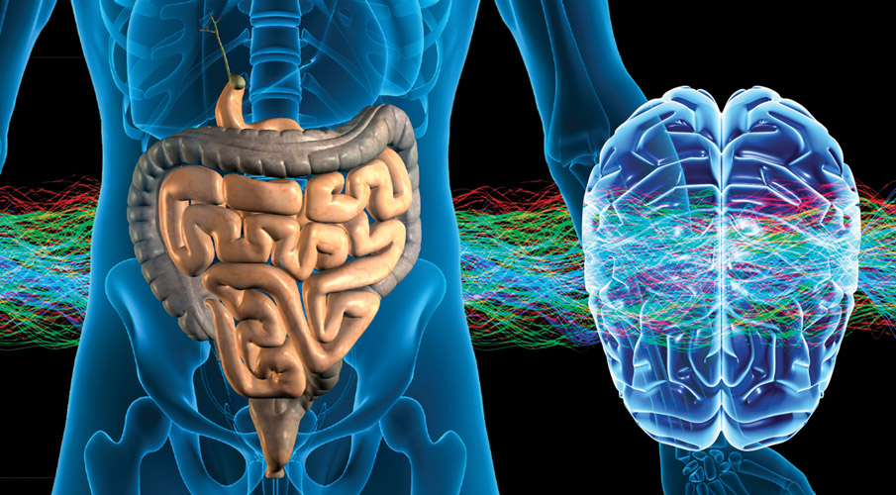
The Brain & Gut Connection
75% of neurotransmitters are created in the gut
Chronic stress alters microbiome > pathogenic microorganisms
Importance of fermented foods and Resistant Starches
Consider Prebiotic (artichokes/leeks/bananas/sunchokes)
Consider Probiotics (sauerkraut/kim chi/miso/tempeh/yogurt)
Notes:
Inulin and oligofructose, berries steel cut oats –SCFA 10X greater cells 150X genes

Slide 11
Principle #4: High quality sleep and regular exercise are essential for optimum brain health

Slide 12
Getting your Zzzzzzz’s
Studies estimate ~90% correlation disrupted sleep and depression.
Make your bedroom – quiet/cool/dark
Create a nighttime ritual
Create a morning ritual
De-stimulation
Invest in your sleep – bed and bedroom
Consistency
Get a night light for the bathroom

Slide 13
Exercise: Preventative & Therapeutic
Reduces Risk of:
Depression & Neurodegenerative disorders (ALZ 45% reduction)
Therapeutic for disorders such as:
Anxiety/Depression/ADHD/Chronic Pain/Schizophrenia
1/week HIIT Training – 1/week resistance training – walking
Notes:
5-10 min a day of running at slower speeds <6mph reduces all cause mortaility. Exposure therapy for self-conscious individuls

Slide 14
Principle #5: Rejuvenate and strengthen the mind by giving it a daily time out in silence

Slide 15
Power of Attention
What you focus on you feel + automatically gives value to
Attention shapes neural circuits
Neuroplasticity
N.E.A.R
What are your attentional practices?
Notes:
The Camera of Your Life

Slide 16
What is Mindfulness? Aka Attentional Skill Training
nonjudgmental attention →present moment
Acceptance = being ok with what is
Attitude = open/curious
ALLIES: 4 ANCHORS + 5 SENSES
PITFALLS– Mind vs. Mind / Results Focused
3 minute meditation
Notes:
What percentage of thoughts did you have today that you had yesterday? Habit

Slide 17
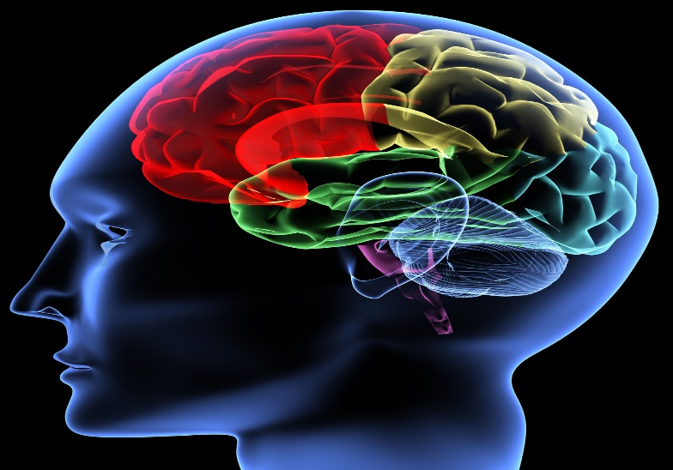
How do Mindfulness Interventions Help?
Stimulates neuroplasticity (mPFC)
Integrates top-down processing (Seigel, 2011)
Improves the precision and accuracy of how you process info
Leads to greater clarity and wisdom
Notes:
Openness (receptive to whatever comes to our awareness, letting go of expectations) Observation (ability to perceive the self, while experiencing an event, broadens our perspective and allows us to see the fuller context in which we are living. Powerful way to disengage from automatic behaviors and habitual responses) Objectivity (capacity of the mind to be aware of the objects of consciousness (thoughts, feelings, sensations) note their transience, and see that they do not define who we are (not getting lost in the target of our attention)

Slide 18
More Science on Meditation….
activation L frontal regions, lifts mood (Davidson 2004)
cortical thinning due to ageing (Lazar et al. 2008)
stress related cortisol (Tang et al. 2007)
immune system (Davidson et al. 2003; Tang et al. 2007)
Helps insomnia/anxiety/phobias/eating disorders (Walsh and Shapiro 2006)

Slide 19
Principle #6: Rhythm and Rituals are vital to a healthy mind and body

Slide 20
The Power of Rituals The Touchstones of Life
The mind and body run on rhythm
and anticipate events
Morning Ritual
I am done with work Ritual
Nighttime Ritual
Add self-soothing elements (songs, aromas, body movements, clothing, tea) to help yourself through your days transitions
Notes:
Lightbulb – 1879 = 139yrs ago

Slide 21
Principle #7: Learn to handle your thoughts and emotions with skill and wisdom = greater happiness

Slide 22
Psychological Strategies: Thinking
Thoughts = transient states of mind, separate from ourselves
Mind = non-stop thought factory – You - QCM. Focus => helpful thoughts
Defusion Techniques
Ask helpful questions….How and What not Why
Notes:
Rumination when dopamine circuits are humming from increased stress start to be more mentally impulsive make stereotyped base judgments heavily biased by the feeling tone and emotionally response.
I am not aware of any other factor in medicine, not diet, smoking, exercise, stress, genetics, drugs, surgery that has a greater impact on our quality of life, incidence of illness, and premature death from all causes – Dean Ornish (on relationships)

Slide 23
Emotions: The Basics
Come as a package deal. If you
suppress one you suppress them all.
(Gross 2002, Gross & John 2003)
Name it To Tame it
Recondition to Value them
“How could it be courageous to be afraid to feel your emotions?”
-D. Kahn, M.D.
Notes:
Suppressing emotions is just as toxic as eating a bag of deep fried oreos, or eating a large steak everyday. Guy with a knife replaced by emotion that is feared.

Slide 24
Principle #8: Social relationships are essential to optimal brain and mind health

Slide 25
Nourish your Heart and Inner Rascal
PLAY - joyful competitive interaction – Emotional Growth / Social Sensitivity -mediated by Dopamine - Prosocial
CARE – Nurture others / Infant Animals / Plants / Music mediated by - Opioid / Oxytocin
Notes:
Oxytocin reduces separation distress, boosts confidence

Slide 26
Social Strategies: Friends with Benefits
Quality > Quantity
psychological health, happiness, cognitive capacity and intelligence
number and severity of physical illnesses and boosts longevity
1984-2004: % of Americans who feel they have no one to talk to about important matters tripled to 25%
Notes:
50% increased likelihood of survival living alone 32% Holt-Luntad (et al 2015) "One thing research shows is that as one's social network gets smaller, one's risk for mortality increases. And it's a strong correlation -- almost as strong as the correlation between smoking and mortality.“ - Julianne Holt-Lunstad, PhD

Slide 27
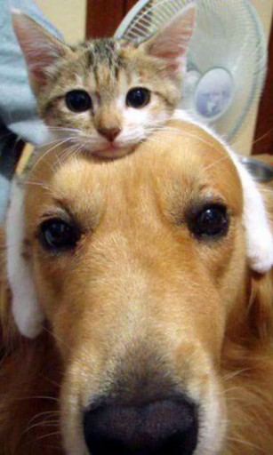
Friendships: get back in contact - meet new people
Join a new group : meetup.com
Volunteer: volunteermatch.org
Use synchrony and music to feel
Connected
"One thing research shows is that as one's social network gets smaller, one's risk for mortality increases. And it's a strong correlation -- almost as strong as the correlation between smoking and mortality.“ - Julianne Holt-Lunstad, PhD
Notes:
I am not aware of any other factor in medicine, not diet, smoking, exercise, stress, genetics, drugs, surgery that has a greater impact on our quality of life, incidence of illness, and premature death from all causes – Dean Ornish (on relationships)

Slide 28
Principle #10: Create a personal program that stacks multiple mind-health strategies: (Commitment with consistent action)

Slide 29
So Where do I begin?
What new rituals do I want to create? Experiment and then commit
Go outside and go for a walk 15-30min + Focus on gratitude
Eat a healthy breakfast ~ same time each day
Take basic supplements: Fish Oils/B-complex/Mg+/Zinc
Create your own positive song list/youtube list
Move to Music
Get connected: People/Plants/Nature/Volunteer
Spend some time (~3-20min) in meditation 6X a week

Slide 30
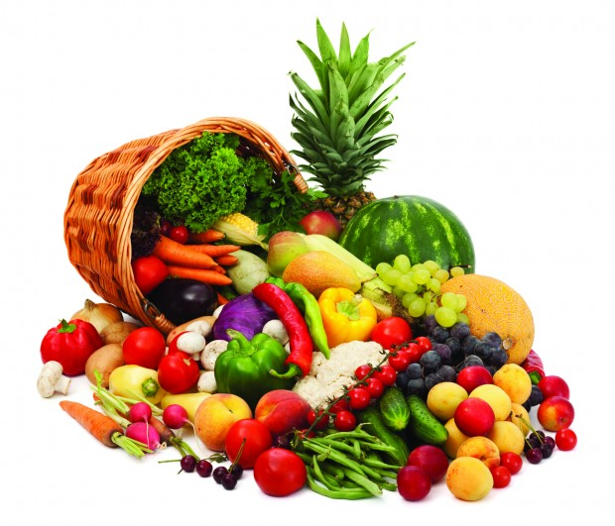
Basic Recipe Formulas
Healthy Breakfast = Oatmeal/Quinoa + Berries + High Omega 3 nuts/seeds (walnuts/flax/hemp/chia seeds) + non-dairy unsweetened milk
Green Power Smoothie = 5oz of spring mix/spinach/kale + Healthy Fats (Avocado/Nuts/Seeds) + Low glycemic fruit (green apples/berries/cherries/pomegranate seeds) + add sweeter fruits to taste (bananas/pineapple/dates) + optional = spices such as cinnamon or lemon juice + non-dairy unsweetened milk (almond/coconut/cashew)

Slide 31
Spiritual
Many resources for guided meditations:
SBintegrativePsychiatry.com
headspace.com
drdansiegel.com/resources/wheel_of_awareness/

Slide 32
Thank YOU SO MUCH !!! WEBSITE: www.SBintegrativepsychiatry.COM Email: Dr.Mantz@SBintegrativepsychiatry@gmail.com Phone: 805-679-3034

